Slide 1
Introduction to programming Hello World in 3 languages 😁
Bruno Capuano
Sr Cloud Advocate @Microsoft
@elbruno | elbruno.com

Slide 2
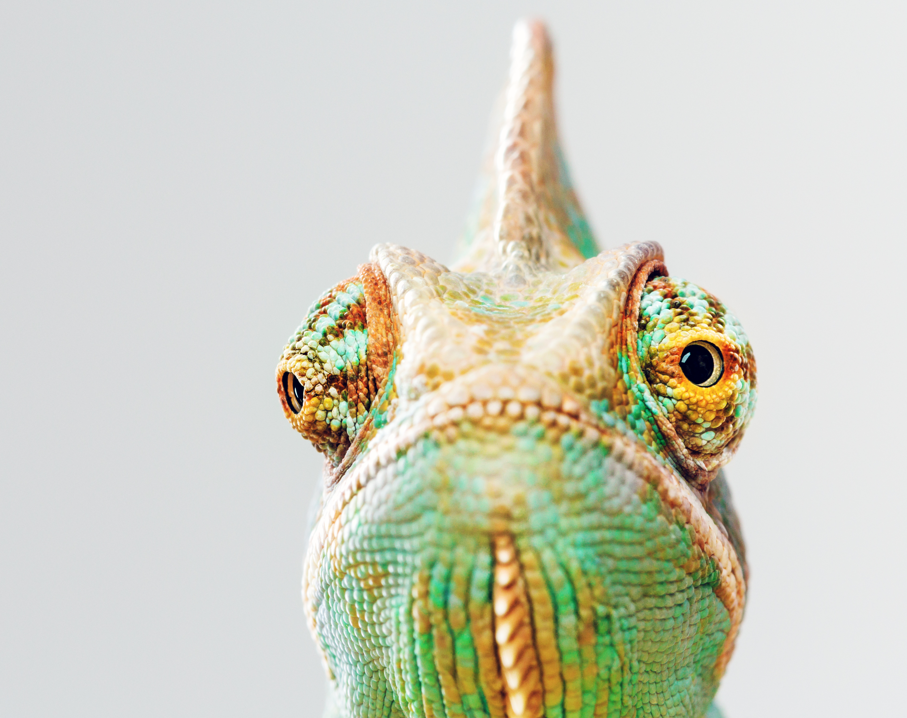

Session Topics
Hello World !
C# / C++, JavaScript, Python, etc …
Lessons Learned

Slide 3

WARNING ⚠️ Excessive use of bad animations and demos!

Slide 4
What is a program?
To start, programs take data (numbers or text) and perform some operations on (or processes) that data
E.g., given two numbers, calculate the greatest common divisor
The result will be displayed on a screen

Slide 5
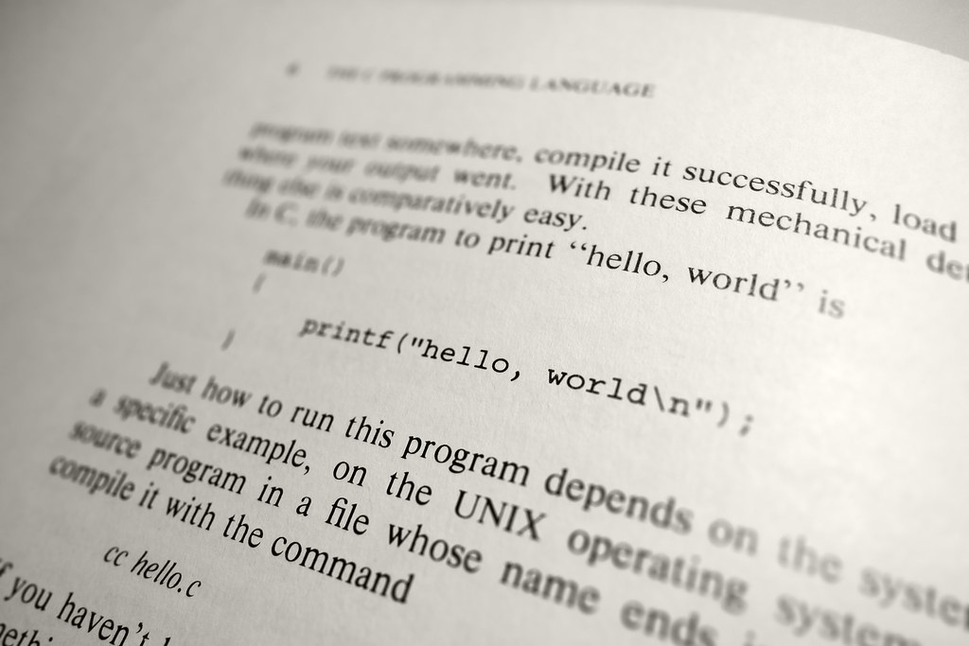
Why “Hello World”?
Brian Kernigham’s 1972 book, A Tutorial Introduction to the Language B.
Bell Laboratories memo in 1974
The first Hello World program appeared in chapter 1.1 of the first edition of Kernighan & Ritchie’s original book about C, ‘The C Programming Language’, in 1978. This is considered to be the first ever “Hello World!” program.
Notes:
https://www.thesoftwareguild.com/blog/the-history-of-hello-world/#:~:text=Traditionally%2C%20Hello%20World%20programs%20are%20used%20to%20illustrate,can%20execute%20Hello%20World%20both%20easily%20and%20correctly.
https://www.mycplus.com/featured-articles/hello-world-programs-in-300-programming-languages/#:~:text=The%20first%20Hello%20World%20program%20appeared%20in%20chapter,to%20be%20the%20first%20ever%20%E2%80%9CHello%20World%21%E2%80%9D%20program.

Slide 6
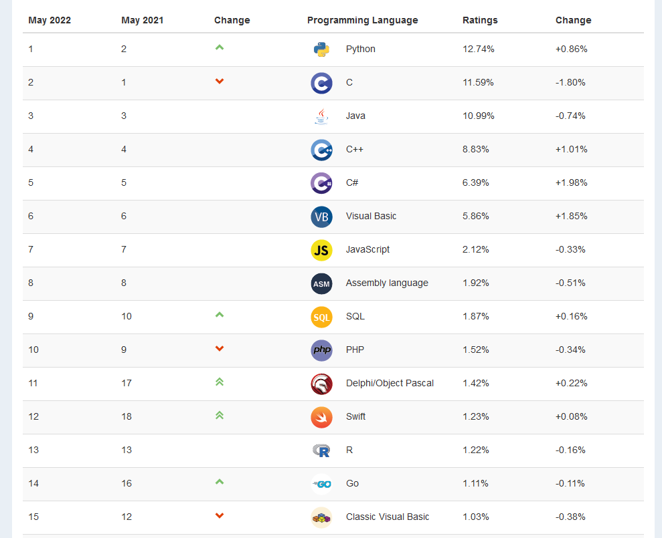
Why “Hello World”?
Notes:
https://www.thesoftwareguild.com/blog/the-history-of-hello-world/#:~:text=Traditionally%2C%20Hello%20World%20programs%20are%20used%20to%20illustrate,can%20execute%20Hello%20World%20both%20easily%20and%20correctly.
https://www.mycplus.com/featured-articles/hello-world-programs-in-300-programming-languages/#:~:text=The%20first%20Hello%20World%20program%20appeared%20in%20chapter,to%20be%20the%20first%20ever%20%E2%80%9CHello%20World%21%E2%80%9D%20program.

Slide 7
Hello, World! in C
#include <stdio.h>
int main(int argc, char* argv[])
{
(void) printf("Hello, world!\n");
return 0;
}

Slide 8
Hello, World! in C++
#include <iostream>
int main(int argc, char* argv[])
{
std::cout << "Hello, world!" << std::endl;
return 0;
}

Slide 9
Hello, World! in Java
class HelloWorld {
public static void main(String args[]) {
System.out.println("Hello, world!");
return;
}
}

Slide 10
Hello, World! in Python
'''
Hello, World! Example program
'''
print('Hello, World!')

Slide 11
DEMO
Introduction to programming Hello World in 3 languages 😁

Slide 12
Next steps
Resources from today!
Microsoft-Build-Student-Developer-Drop-in-day Resources
Student Hub
https://aka.ms/learnstudent
Cloud Skills Challenge https://aka.ms/StudentDeveloperDayChallenge

Slide 13
Introduction to programming Hello World in 3 languages 😁
Bruno Capuano
Sr Cloud Advocate @Microsoft
@elbruno | elbruno.com

